Slide 1
Path Integral Methods for Light Transport Simulation: Theory & Practice
Introduction to Markov Chain and
Sequential Monte Carlo

Slide 2
Markov Chains

Slide 3
Markov Chain: Introduction
Imagine a molecule moving randomly in space
Current molecule position $x_{n}$ - current state
Time is discrete ($n=0,1,2,..$), $x_{0}$ - initial state
Set of all possible positions is a state space
It takes a new position $x_{n+1}$ with some probability ${P(x}_{n+1}\left|x_{n}\right)$ based on position $x_{n}$
Notes:
One intuitive way of thinking about a Markov chain would be to imagine it as a molecule performing random movements in a gas or fluid. We imply an important assumption that the molecule has no memory, i.e. its next move depends solely on its current position and does not depend on any of its previous positions. In this case, such memory-less process is called a Markov chain. Current position $x_{n}$ of the molecule at time n is called a current state of the Markov chain. If time n is continuous, the process is called time-continuous Markov Process. Hereafter we will consider only Markov chains with discrete time. The position $x_{0}$ of the molecule at time n=0 is called an initial state of the Markov chain. The space of all possible positions of the molecule is called a state space, on which a Markov chain is defined. The molecule moves probabilistically in this medium, such that for each current position of the molecule (current state) $x_{n}$ and any desired position $x_{n+1}$(proposal state) for the next move there is defined a conditional transition probability ${P(x}_{n+1}\left|x_{n}\right)$ of performing such move.
Now we will move away of the molecule example. That means that the state $x$ of the Markov chain can belong to any abstract state space Ω. For example, as we will see later a state $x$ can correspond to a complete light path from a light source to a camera sensor.

Slide 4
Markov Chain
Random walk implies a transition probability for each move ${P(x}_{n+1}=j\left|x_{n}=i\right)≡P_{i→j}$
At each move the chain forms a posterior distribution over state space
A histogram of all visited states up to move $n$
Detailed balance defined as $P_{i→j}=P_{j→i}$
Notes:
One intuitive way of thinking about a Markov chain would be to imagine it as a molecule performing random movements in a gas or fluid.
The random walk implicitly defines the conditional transition probability $P$ for every move.
For every current state $i$ and a proposal state$j$ at move $n$ a transition probability ${P(x}_{n+1}=j\left|x_{n}=i\right)$ is defined. Hereafter we will denote this probability simply as $P_{i→j}$ for brevity. After $n$ moves we can build a histogram of all visited states up to the move $n$. This histogram forms a posterior probability distribution which evolves with every move $n$. This posterior distribution is induced by the constructed Markov chain.
One important property of the transition probability is called detailed balance. It implies symmetry of the transition probability, i.e. the transition from state $i$ to state $j$ is equally probable as the transition back from $j$ to $i$. Intuitively that means that the random walk can be reversed. A Markov chain running with such symmetric transition probability is called a reversible Markov chain. Physically speaking, detailed balance implies that, the random walk from state i to state j is always compensated by the reverse random walk, keeping the system in equilibrium.

Slide 5
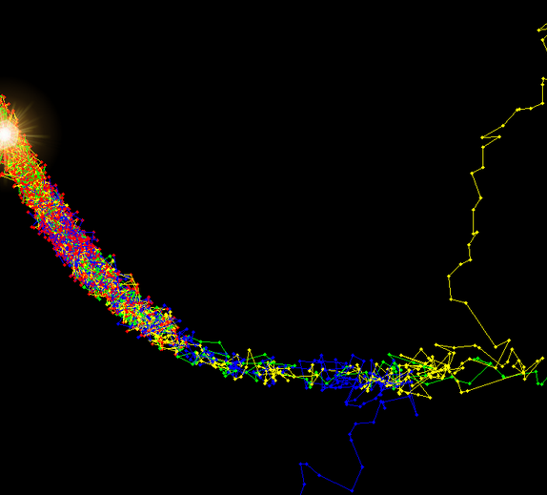
Markov Chain
Posterior converges to the target distribution if the detailed balance obeyed and all states are reachable (ergodicity)
With “bad” initial state $x_{0}$ the start-up bias (burn-in phase) can be significant
Burn-in
area
$$x_{0}$$
Equilibrium
$$x_{0}$$
$$x_{0}$$
Notes:
If the detailed balance is obeyed and all states of the path space can be reached by the proposed transition rules of the proposal distribution then a Markov chain converges to a unique stationary distribution as number of moves $n→∞$.
Such stationary distribution is called an equilibrium or target distribution of a constructed Markov chain and the chain is called ergodic.
The trajectory to the target distribution can take many steps and depends on the initial state $x_{0}$ of the Markov chain. Illustration on the right show three different Markov chains (yellow, green and blue) converging to the same equilibrium distribution from different initial states. The highlighted equilibrium zone roughly denote the high-probability region of the unimodal banana-shaped target distribution and receives the most samples.
The zone on the right half of the illustration shows the so-called “burn-in zone” – the phase when a Markov chain is located in the regions of low probability of the target distribution. If such phase is too long, it can shift the resulting posterior distribution from the target distribution, because a lot of visited states can lie in the low-probability regions of the target distribution. Thus this effect caused by a not properly chosen initial state is called start-up bias.
So practically it is very important to seed a Markov chain with an initial state that lies in high probability regions of the target distribution. That leads to faster convergence of the posterior distribution to the target distribution.

Slide 6
Metropolis-Hastings Algorithm

Slide 7
Metropolis-Hastings (MH) Algorithm
Goal: Random walk according to a desired function $f$
Define conditional rejection sampling probability
$$a_{i→j}=\frac{f\left(x_{j}\right)}{f\left(x_{i}\right)}=\frac{f_{j}}{f_{i}}$$
$a_{i→j}$ is acceptance probability at state $i$for proposal state $j$
Detailed balance is affected as $a_{i→j}P_{i→j}=a_{j→i}P_{j→i}$
Posterior distribution is then proportional to $f$
Accurate to a scaling factor = normalization constant
Notes:
Assume we have some function $f$ that can be evaluated point-wise. We cannot directly sample from $f$. However we still want to sample proportionally to $f$.
We can construct a Markov chain, whose posterior distribution converges to the function of interest $f$ accurate to the normalization factor (since $f$ is generally not normalized). This method was first proposed by Metropolis in 1953 and then generalized by Hastings in 1970 for arbitrary target distributions. The idea is to alter the transition distribution by affecting it by a conditional rejection sampling probability based on the desired target distribution. This probability is similar to the ordinary rejection sampling probability, however the key difference is that it is conditional on the current state, that is, $a_{i→j}=\frac{f_{j}}{f_{i}}$ means that it’s a probability of conditionally accepting the new proposal state $j$ given current state $i$. It is called an acceptance probability because at each move $n$ of the Markov chain we either accept the proposal state $j$ with probability $a_{i→j}$ or otherwise reject it and keep the current state $i$ (with probability ${1−a}_{i→j}$ accordingly).
Given that the transition probability is selected such that the detailed balance is obeyed, the posterior distribution of the constructed Markov chain will converge to the desired target function $f$. Note that the detailed balance equation is affected by this acceptance probability. Important to note that the Metropolis-Hastings algorithm always constructs a normalized pdf, while the original target function is not necessarily (and is usually not) normalized. Thus this poses another important problem of finding the normalization constant of $f$, i.e. the integral of $f$ over the whole state space. This can be as hard as the original problem. However we will see that for particular needs of light transport it can be easily estimated using one of alternative methods.

Slide 8
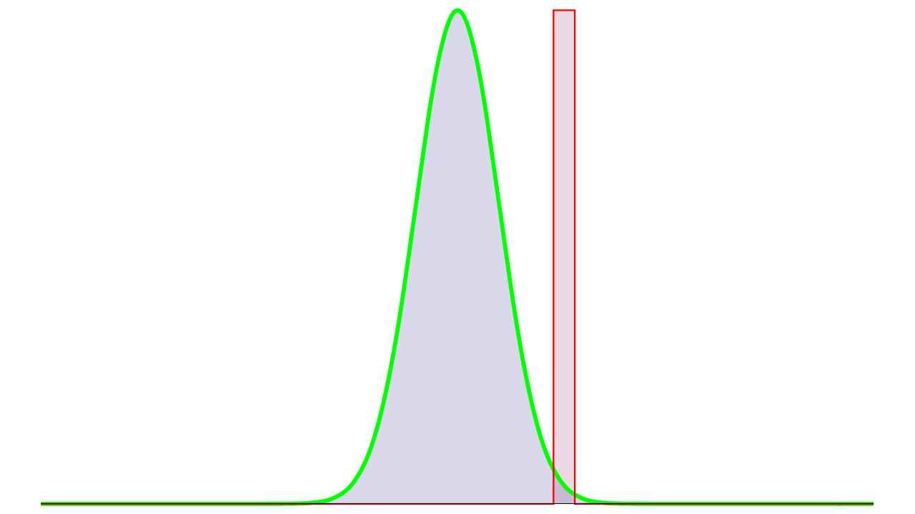
Metropolis-Hastings: Example
$$x_{0}$$
Notes:
Here we show a simple step-by-step example of Metropolis-Hastings algorithm in action. We consider a simple 1D case of unimodal normal distribution $ℕ$ depicted in green. We will run Markov chain with uniform random walk and the acceptance probability being the ratio of values of proposal to current state, as was described.
We start with some initial state $x_{0}$ chosen to be close to the high-density region of the target function.
This already forms the posterior distribution with one bar of the histogram, depicted in red under the position of the initial state.

Slide 9
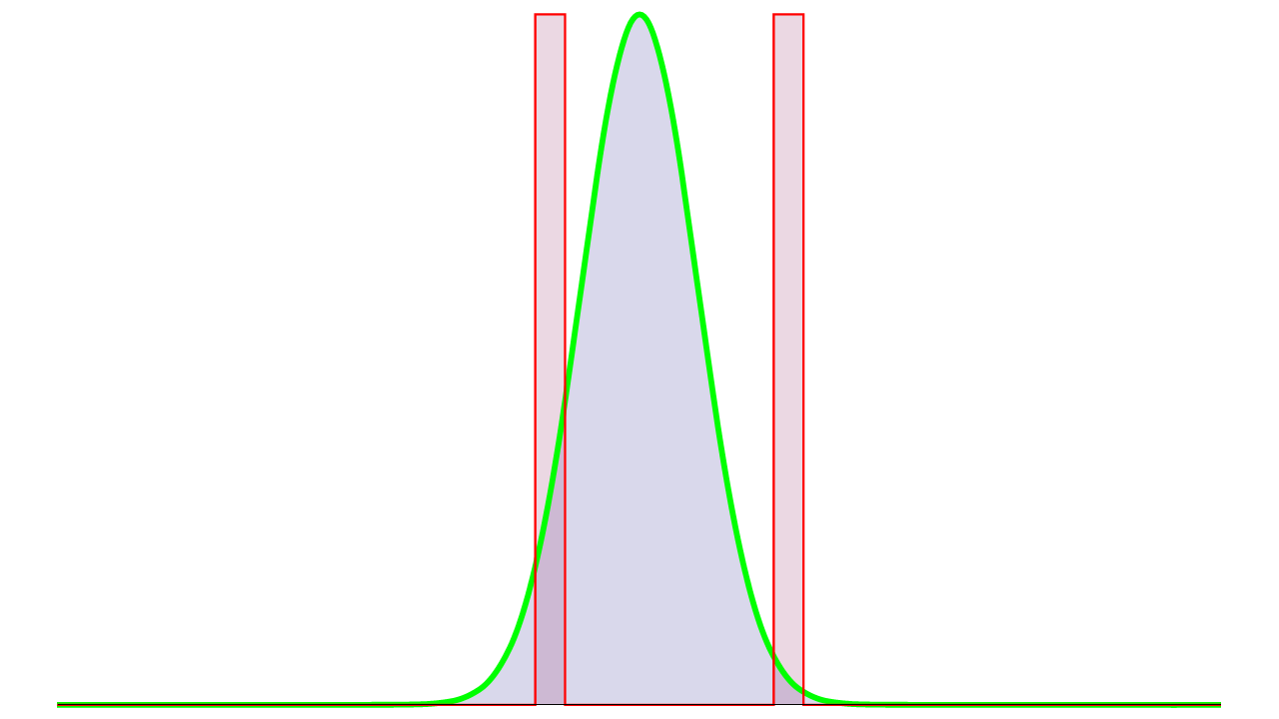
Metropolis-Hastings: Example
$$x_{1}$$
$$x_{0}$$
$$a_{x_{0}→x_{1}}=\frac{ℕ(x_{1})}{ℕ\left(x_{0}\right)}>1$$
$$ℕ(x_{1})$$
$$ℕ(x_{0})$$
Notes:
In order to make the first move we generate a proposal state $x_{1}$ with uniform random walk and compute the acceptance probability as $a_{x_{0}→x_{1}}=\frac{ℕ(x_{1})}{ℕ\left(x_{0}\right)}>1$. That implies an unconditional acceptance of the new proposal state.

Slide 10
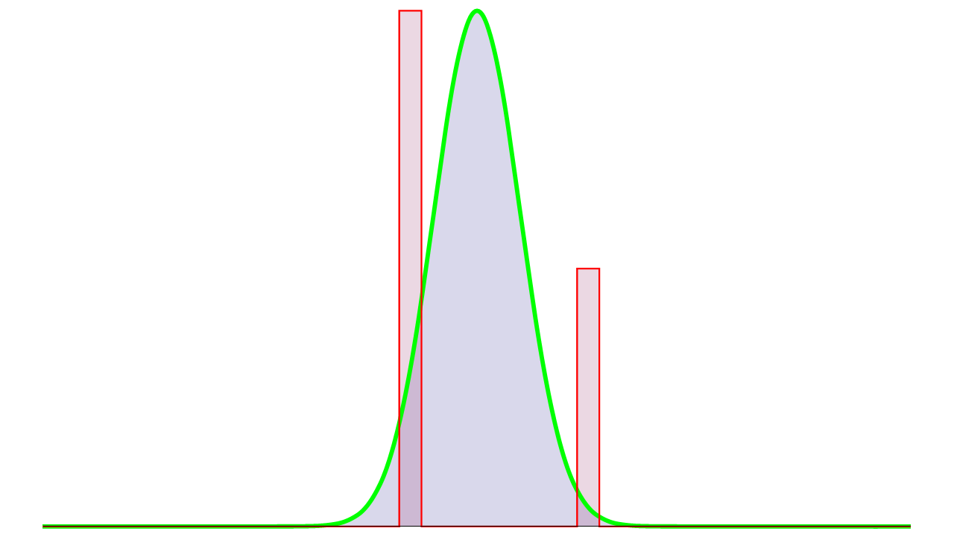
Metropolis-Hastings: Example
$$x_{2}′$$
$$x_{1}$$
$$a_{x_{1}→x_{2}}=\frac{ℕ(x_{2})}{ℕ\left(x_{1}\right)}≪1$$
Notes:
At the second step again we generate a new proposal, this time from a low-density region. Thus the acceptance probability $a_{x_{1}→x_{2}}=\frac{ℕ(x_{2})}{ℕ\left(x_{1}\right)}$ is very low. Thus if we make a move, most probably such a proposal will be rejected.
It is important to note at this point that the current state of the Markov chain does not change ($x_{2}$ becomes $x_{1}$), however every move affects the histogram. Thus the peak at the current state become more prominent.

Slide 11
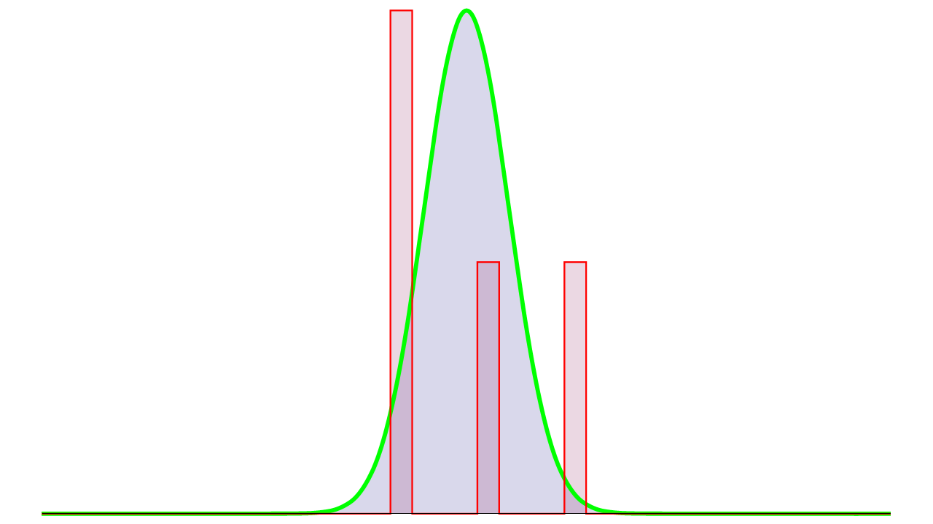
Metropolis-Hastings: Example
$$x_{2}$$
$$x_{3}$$
Notes:
Now we generate a proposal in a high-density region. That leads to unconditional acceptance of the new proposal $x_{3}$.

Slide 12
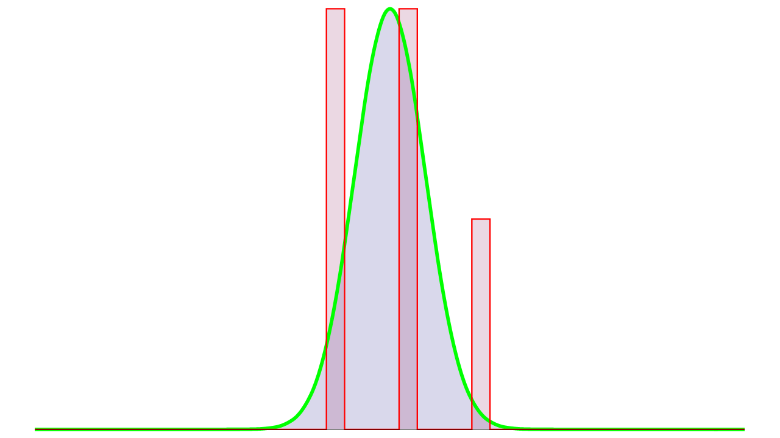
Metropolis-Hastings: Example
$$x_{4}′$$
$$x_{3}$$
Notes:
The next proposal is also rejected due to the low value of the target function. Again that leads to one more sample added to the histogram at the current state.

Slide 13
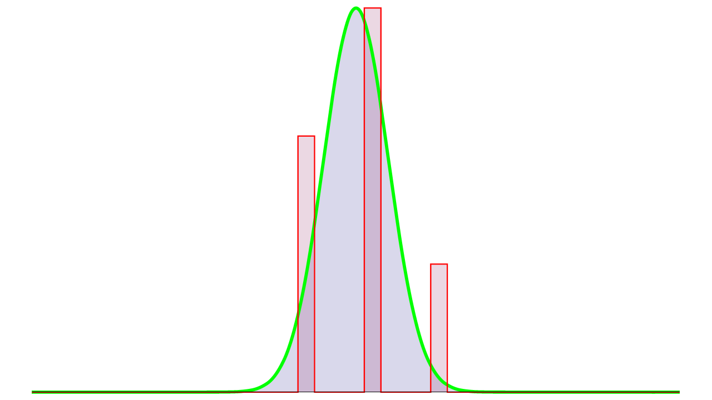
Metropolis-Hastings: Example
$$x_{4}$$
$$x_{5}′$$
Notes:
One more time the proposal is rejected. This is the natural behavior if the chain is stuck in a very high-density region of the target function. Note that many sequential rejections might also increase the correlation of samples, thus slowing down the convergence.

Slide 14
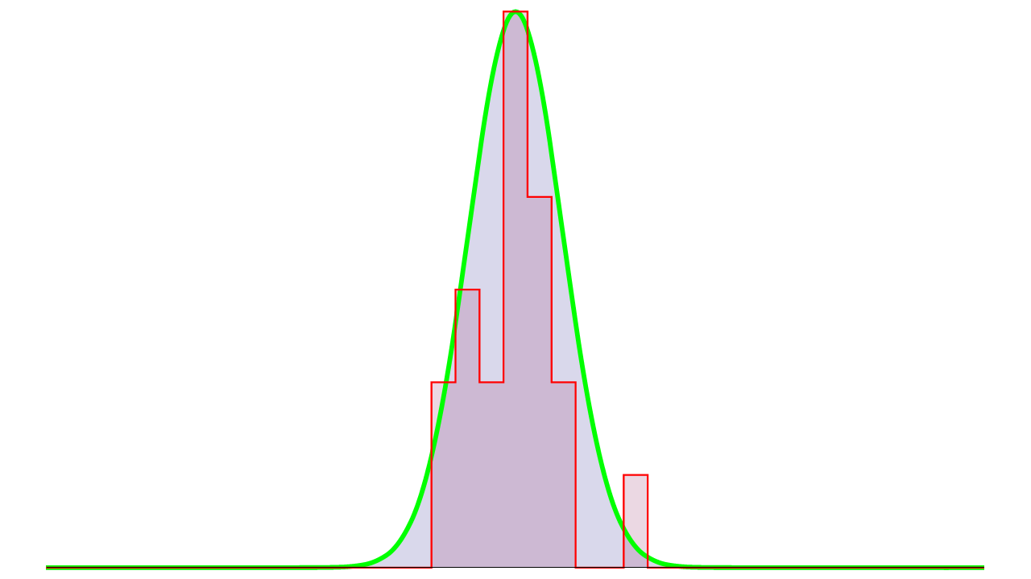
Metropolis-Hastings: Example
$$n=20$$
Notes:
This is the posterior distribution produced by the Markov chain after 20 moves.

Slide 15
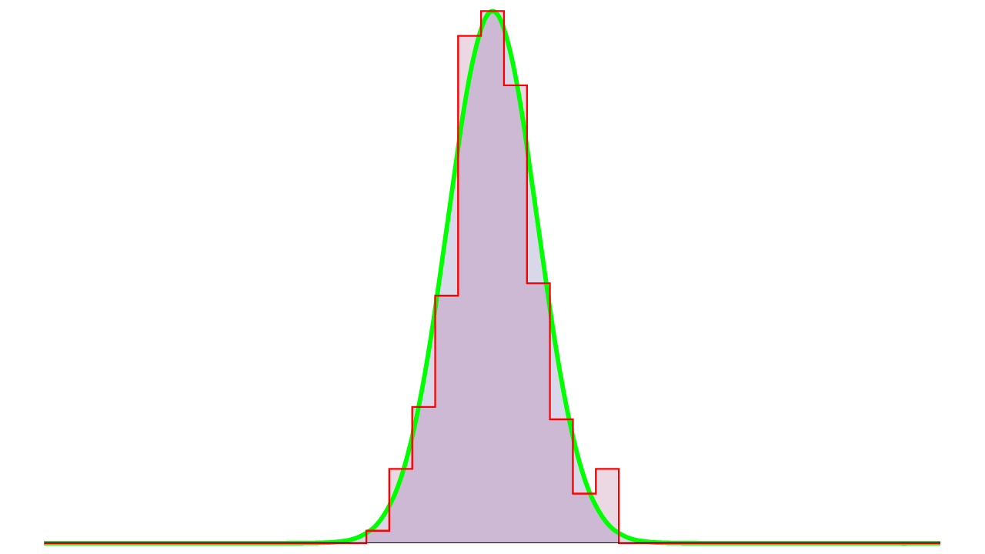
Metropolis-Hastings: Example
$$n=200$$
Notes:
This is after 200 moves.

Slide 16
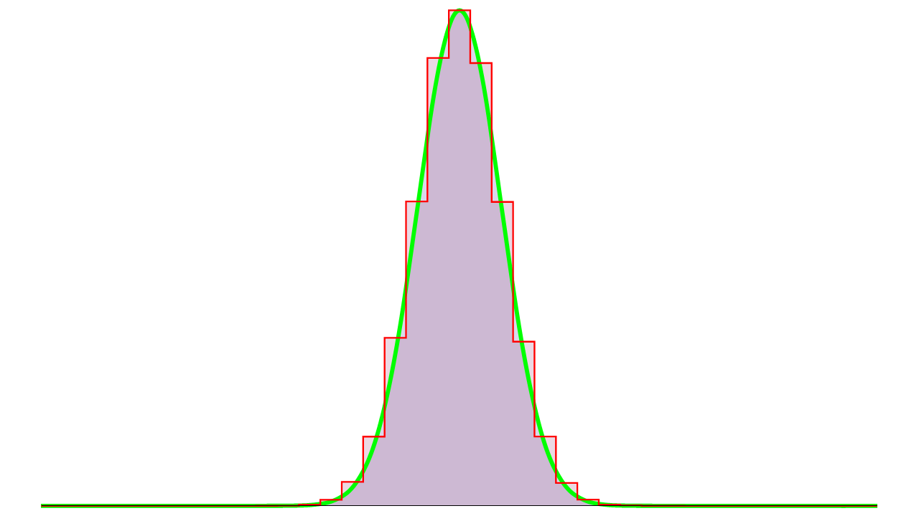
Metropolis-Hastings: Example
$$n=2000$$
Notes:
And this is the after 2000 moves. As we can see the posterior distribution closely converges to the target function.

Slide 17
Importance Sampling for M-H
Cannot fetch proposals directly from $f$
Generate a proposal $j$from some proposal distribution $T$
Similar to importance sampling in Monte Carlo
$T$ can depend on the current state $i$: $T_{i→j}$
New transition probability $P_{i→j}=a_{i→j}T_{i→j}$
Acceptance probability is then (from detailed balance):
$$a_{i→j}=\left(\frac{f_{j}}{T_{i→j}}\right)/\left(\frac{f_{i}}{T_{j→i}}\right)$$
Notes:
In practical situations, doing just a uniform random walk around the state space might lead to a poor exploration of state space (important features might be missing or under-sampled).
In this case, one can generate new proposals according to some importance function (proposal distribution) T, which is somewhat similar to f. Then, we can separate the transition in two sub-steps: the proposal and the acceptance-rejection. The proposal distribution T is the conditional probability of proposing a state x_j given x_i, and the acceptance probability a the conditional probability to accept the proposed state x_j. The transition probability P then can be written as the product of them. This is almost equivalent to the importance sampling technique used in Monte Carlo.
The key difference is that such importance function in MCMC can also depend and rely on the current state! This function is called transition probability function.
And the acceptance rate should account for this transition probability similarly to Monte Carlo methods (by dividing the value of f by the probability of sampling it).

Slide 18
Correspondence Table
Ordinary Monte Carlo | Markov chain Monte Carlo
Convergence rate, usually $O(\frac{1}{\sqrt{N}})$ | Mixing rate, depends on multiple factors, can be geometric $O\left(γ^{N}\right),γ∈(0;1)$
Convergence to an expected value | Convergence of the posterior to the target distribution (e.g., in total variation)
Importance sampling distribution $p(x)$ | Proposal distribution $T_{i→j}$
Variance of the estimate | Acceptance rate, correlation of samples
Number of samples | Number of moves (mutations)
Notes:
This table shows the correspondence between the major terms and properties used in ordinary Monte Carlo (MC) to the equivalent terms used in Markov Chain Monte Carlo (MCMC).
Note that the theoretical convergence of MCMC methods can be fundamentally different comparing to ordinary MC methods.
The convergence in context of Markov chains is usually referring to the convergence of the posterior distribution to the target distribution (in some norm, for example, in total variation).
We have proposal distribution instead of importance function. Note that we have much more freedom in constructing this proposal distribution, because we can also rely on the current state of a Markov chain.
The error of MH is very hard to compute, since the samples are inherently correlated. So, we cannot use just variance anymore. Acceptance rate can be a good initial indicator of the MCMC sampler performance.
And, instead of number of samples, we have number of moves made by Markov chain.

Slide 19
Metropolis Light Transport
Notes:
Now, I’ll try to explain how we can apply MH algorithm in the context of light transport.

Slide 20
Image Generation
Reduce per-pixel integrals to a single integral
Each pixel has an individual filter function then
Compute the distribution over the image plane
Bin this distribution into corresponding pixels
Walk over the image plane
Notes:
In order to achieve more efficient exploration of the path space and utilize the potential correlation between the separate integrals for each pixel, we reduce the task to a single integral. Each pixel integral can be then deduced by applying a pixel filter.
This single integral computes the distribution of flux on the image plane.
Then we can obtain the image by just distributing the corresponding samples from the posterior distribution into the corresponding bins of image pixels.
This way the MH algorithm is able to freely walk over the complete image plane while exploring important parts of the image adaptively.

Slide 21
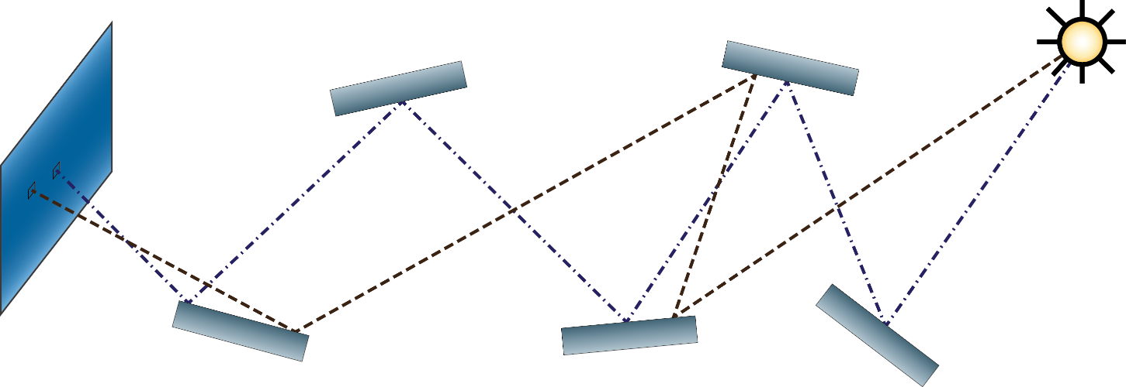
Metropolis Light Transport
State space = space of full paths, path space
What is the function $f$ for light transport?
Interested in flux arriving at image plane
Notes:
So, ideally, we are interested in all possible trajectories (paths) from light source to camera.
This naturally forms the state space for a Markov chain: now each state is a full path from light source to the camera. This state space is called a path space in light transport.
How would one define a target function for Metropolis-Hastings algorithm in context of light transport?
Ideally, we’re interested in the equilibrium distribution of flux incident to the image plane.

Slide 22
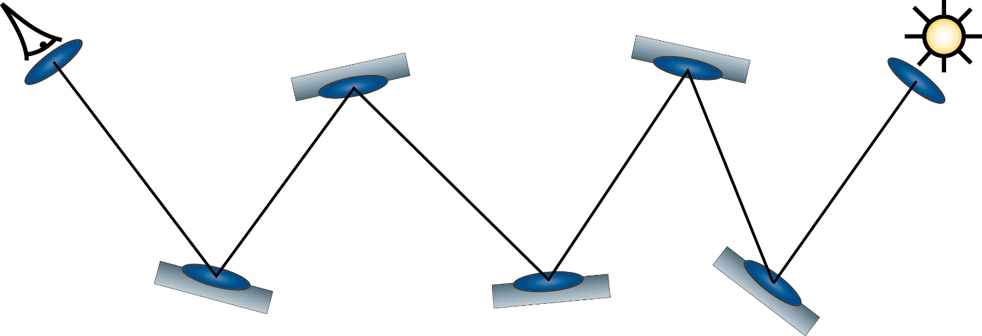
Measurement Contribution
Measurement contribution $f$ for $k$-length path
$$f({\overline{x}}_{k})=L_{e}G\left(\prod_{k−1}{ρ_{k}G_{k}}\right)W_{e}$$
$$W_{e}$$
$$ρ$$
$$L_{e}$$
$$ρ$$
$$G$$
$$G$$
$$G$$
$$G$$
$$G$$
$$G$$
$$ρ$$
$$ρ$$
$$ρ$$
Notes:
Thus, as was explained before by Jaroslav, we can introduce the measurement contribution function for a path x_k.
It consists of subsequently interleaved events: emission(L_e)->propagation(G)->scattering(rho_r)->propagation(G)-> …. -> absorption by sensor (W_e)
and provides the contribution carried by the path.

Slide 23
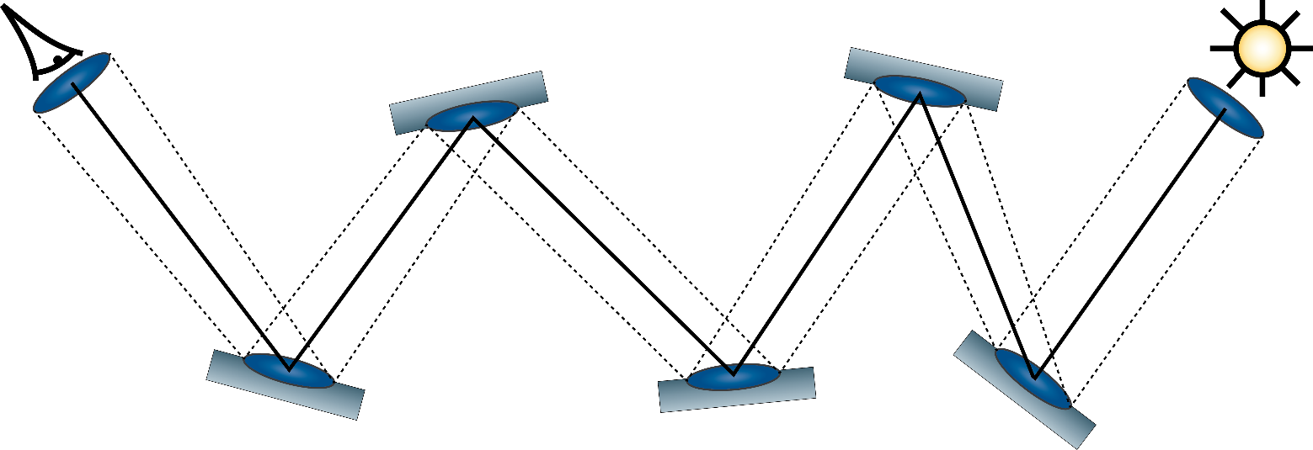
Measurement Contribution
$$f\left({\overline{x}}_{k}\right)=\prod_{k}{\frac{dQ}{dA_{k}}=\frac{dQ}{dμ_{k}}} \left[W/{{(m}^{2})}^{k}\right]$$
Flux through all differential areas of a path
$$dA$$
$$dA$$
$$dA$$
$$dA$$
$$dA$$
$$dA$$
$$dA$$
Notes:
Let’s take a closer look at the physical meaning of the measurement contribution $f$.
Eric Veach showed in his PhD thesis that we can define the measurement contribution as chain derivative of energy with respect to surface areas at each interaction. By folding the product, we get that the measurement contribution $f$ is a derivative of energy function $Q$ with respect to the area product measure $μ_{k}$.
The physical quantity of the measurement contribution is Watts per square meter to the $k$th power.
Intuitively, it defines an energy flow through a differential beam around the path.
In other words, we count the number of photons going through the infinitesimal beam around the path.
This definition reveals the underlying physical justification behind Metropolis light transport.

Slide 24
Comparing Paths
MH needs to compare two states (paths)
Use flux through the infinitesimal path beam
Directly comparable for equal-length paths
Compare flows of energy through each path
For different lengths the measure is different
Always compare fluxes going through each path
Notes:
In context of MH, we always need to be able to compare two different paths.
As we know, the measurement contribution f provides the amount of flux going through the infinitesimal beam around the path.
This makes the paths of equal length directly comparable to each other in terms of the carried energy.
The only remaining question is how to compare paths of different lengths?
Interestingly, if we define our integration measure as a product area measure, which adjusts based on the path length, then we can directly compare the amount of energy (e.g. number of photons) going through the path.

Slide 25
Path Integral
For path of length $k$: $I_{k}=\int_{Ω_{k}}{f\left(\overline{x}\right)dμ_{k}(\overline{x})}$
Combine all path lengths into a single integral
Use unified measure for all paths $dμ\left(D\right)=\sum_{k=1}^{∞}{{dμ_{k}(D∩Ω}_{k})}$
Compare paths of different length
Compare groups of paths
Use $f$ in Metropolis-Hastings!
Notes:
So, we can construct a MH integration process for all paths of the same length k.
However, we need to construct a single generalized integral.
This can be done by just treating this family of integrals as a single generalized path integral.
In this case, we can introduce a generalized product area measure $dμ$ as a sum measure.
This enables us to use a single integral for paths of all lengths for MH.
Moreover, this way we can compare all paths and even groups of paths with each other in the context of carried energy (flux). This way we can compare paths of different lengths directly. Thus we can use measurement contribution function as a target function for random walk in MH algorithm.

Slide 26
Metropolis Light Transport
Generate initial path ${\overline{x}}_{0}$ using PT/BDPT
Mutate with some proposal distribution $T_{{\overline{x}}_{i}→{\overline{x}}_{j}}$
Accept new path ${\overline{x}}_{j}$ with probability $a_{{\overline{x}}_{i}→{\overline{x}}_{j}}$
Accumulate contribution to the image plane
Go to step 2
$${\overline{x}}_{1}$$
$${\overline{x}}_{0}$$
$${\overline{x}}_{2}$$
Notes:
We showed how light transport can be reformulated for MH integration.
Now I’ll outline the actual steps of the MLT algorithm:
We generate an initial state (full path) of a Markov chain using one of the existing sampling methods (e.g. PT or BDPT).
Then we start the actual mutation process. Mutate the current path using one of the available mutation strategies, compute the proposal density.
Compute the acceptance probability as was discussed earlier, accept the new proposed path according to this probability.
Accumulate the contribution of the current path to the image plane, apply pixel filter to bin the path into the corresponding pixel in-place.
Proceed to step 2 to cycle the random walk.

Slide 27
Advantages
More robust to complex light paths
Remembers successful paths
Utilizes coherence of image pixels
Explores features faster
Cheaper samples
Correlated
Flexible path generators (mutations)
Notes:
I’d like to emphasize that we have already quite good methods for image rendering, like BDPT.
So, why do we need yet another, more complicated rendering method?
First of all, MLT is much more robust to the complex light paths, meaning that it tries to “remember” the successful paths. That is, the current state of a Markov chain is always a correct full path from light source to the camera.
As another advantage, Markov chain can easily explore the similar surrounding paths by perturbing the current path slightly, thus exploring the whole illumination features at a low cost. On the other hand, this can also cause some unwanted correlation of samples, slowing down the rendering convergence.
And last, but not the least, MLT framework provides us the great freedom of constructing path generators for almost any special situation.

Slide 28
Energy redistribution path tracing [Cline05]
Run many short Markov chains for each seed
Adaptive number of chains according to path energy
In spirit of Veach’s lens mutation
Notes:
ERPT is a variation of MLT and it utilizes the fact that independent samplers, like BDPT, already provide a very good distribution.
The idea is to try to redistribute the amount of energy carried by each initial path.
In order to do that, multiple Markov chains are started with the same seed path, the number of chains is computed adaptively based on the path energy.
This scheme is very similar to the lens mutation proposed by Eric Veach with the number of mutations between reseedings of the chain being very low.
Efficiency of ERPT depends a lot on the seeding sampler – how good it is. E.g. BDPT w/o MIS provides very unbalanced sampling, leading to ERPT being stuck for a long time in some regions due to high redistribution workload.
Moreover, the distribution region is manually set, making it non-trivial to tweak the parameters to achieve the best redistribution vs. stratification trade-off.

Slide 29
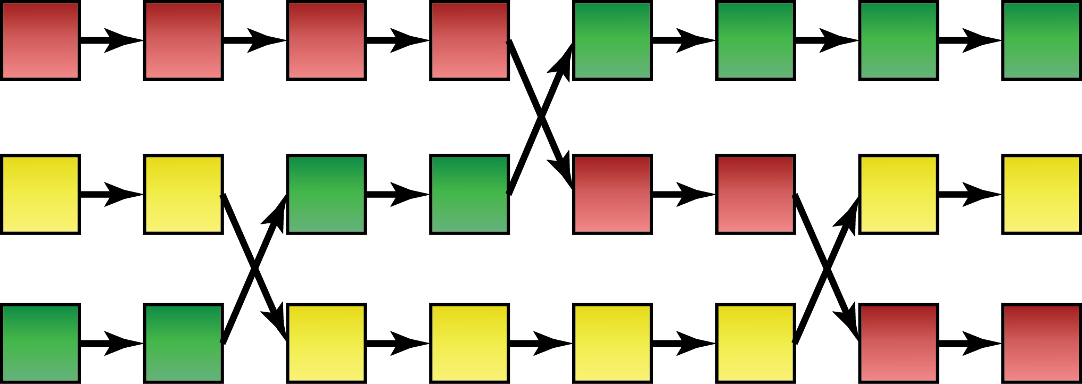
Variations and Improvements
Replica exchange [Kitaoka09]
Run separate Markov chain(s) for specific features
Exchange the discovered paths between chains
Chain 1
Chain 2
Chain 3
Notes:
Replica exchange has been known for a while in statistical MCMC field and was recently introduced in context of light transport.
The idea is relatively simple. Imagine that one mutation strategy can easily discover important features and another mutation strategy can easily explore such features, but has difficulties discovering them.
In this case, we can run two separate chains with these two strategies, and once the “discovering” chain has found a feature, it passes this feature to another chain to explore it. This way the “discovering” chain is responsible for finding important features, while these features can be efficiently explored by the second chain.

Slide 30
Normalization and Start-up Bias in MLT

Slide 31
Differences to MCMC
We do have a good alternative sampler
Path tracer / bidirectional path tracer
Easy to compute normalization constant
No start-up bias, start within the equilibrium
Start many chains stratified over path space
Scales well with massively parallel MLT
Notes:
The key difference of MLT compared to the usual MCMC situation is that we already have methods that can generate an image very well in most situations.
So, many regular MCMC problems like normalization constant estimation and start-up bias are solved easier.
For example, in order to compute the normalization constant, which is just an average flux received by the image plane, it is practically sufficient to sample a few hundred thousand paths with BDPT, which is a negligible cost comparing to the actual image rendering.
As for the start-up bias, we can seed Markov chains directly within the high-probability regions of the target distribution.
The usual practice is to collect many samples from BDPT and then seed Markov chain with one importance-sampled w.r.t. the path contribution. In case of many chains, their initial states can be also stratified with respect to the path contribution to have a good initial coverage of the path space.
And it also scales naturally well with tens of thousands of Markov chains for massively parallel devices like GPUs.

Slide 32
Mutation Strategies and Their Properties
Notes:
Let’s try to understand how to mutate the paths.

Slide 33
Good Mutation Criteria
Lightweight mutation: change a few vertices
Low correlation of samples
Large steps in path space
Good stratification over the image plane
Hard to control, usually done by re-seeding
It’s OK to have many specialized mutations
Notes:
First of all, it is important to understand what criteria should an ideal mutation strategy fulfill.
So, the mutation should be as lightweight as possible, that is, it should try to introduce minimal changes to the path, triggering as few vertex updates as possible.
Then it should also produce a sequence of samples with low correlation, doing large steps in path space.
Also, specific to the image rendering process, the mutation should try to sample the image plane as uniform as possible. That is usually hard to control in the context of MCMC, thus the best practice is to reseed the chain with paths stratified over the image plane.
And finally, it is completely fine if the mutation can efficiently explore only some certain subset of path space, for example only caustics, leaving other features to other specialized mutations. In the end, that is one of the advantages of MLT.

Slide 34
Existing Mutation Strategies
Notes:
Now I’ll do an overview of the existing mutation strategies.

Slide 35
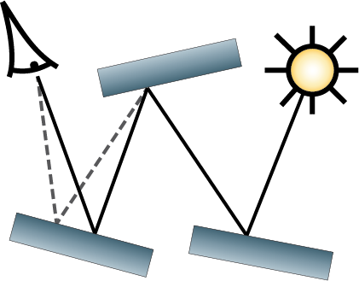
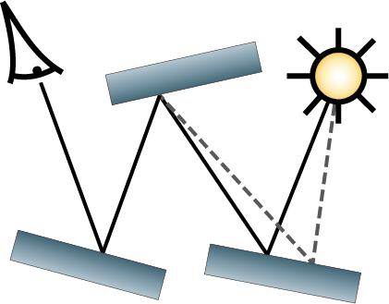
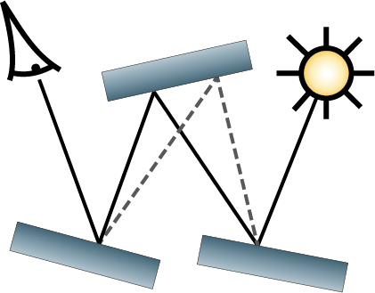
Veach Mutations
Minimal changes to the path
Lens, caustics, multi-chain perturbations
Large changes to the path
Bidirectional mutation
BDPT-like large step
Lens mutation
stratified seeding on the image plane
Lens
perturbation
Caustics
perturbation
Bidirectional
mutation
Notes:
Eric Veach has first introduced MLT and proposed the original set of mutation strategies.
We can roughly classify them into two groups.
The first group perturbs the current path slightly, thus such mutations are called perturbations.
They are mostly crafted to efficiently explore the image plane and such difficult effects as caustics and chains of them.
Another group of mutations tries to do large changes to the path.
Namely, bidirectional mutation works similarly to BDPT, with the only difference that it completely resamples not the full path, but a randomly selected subpath of the current path.
Lens mutation reseeds the chain with a path from the pool of paths stratified over the image plane.

Slide 36
Kelemen Mutation
Mutate a “random” vector that maps to a path
Symmetric perturbation of “random” numbers
Use the “random” vector for importance pdfs
Primary space: importance function domain
Assume the importance sampling is good
Notes:
A popular mutation proposed by Kelemen is to mutate the paths in the so-called primary sample space, that is, the original space of the importance functions used for constructing the path in BDPT and PT.
Usually it is represented as a vector of random numbers in the unit hypercube, which is perturbed using some symmetric probability, like a multidimensional Gaussian distribution.
The major assumption is that the importance sampling functions already make the integrand flat enough that we can walk it using some uniform random walk in this primary space.

Slide 37
Kelemen Mutation, Part II
Acceptance probability $a_{i→j}=\left(f_{j}/p_{j}\right)/\left(f_{i}/p_{i}\right)$
Easy to compute: just take values from PT/BDPT
Large step: pure PT / BDPT step
Generate primary sample (random vector) anew
Notes:
The good thing about this strategy is that a lot of terms just cancel out in the ratio of measurement contribution to the proposal probability density (that is required to compute the acceptance probability).
Thus, since the perturbation probability is also symmetric, the final acceptance probability is computed as a ratio of the simple path throughputs computed by PT or BDPT. [This makes it very simple to implement such a mutation strategy: just take an existing PT or BDPT, replace the random number generator by a replayable sampler with symmetric perturbation and use the ratio of throughputs as an acceptance probability.]
In order to discover new features quicker, we also need to do some large steps. For this reason a large step mutation was proposed. The idea here is also simple: just regenerate the complete random vector from scratch and try to construct a path. That is equivalent to just generating a random path with PT / BDPT.

Slide 38
Manifold Exploration Mutation
Works in the local parameterization of current path
Can connect through a specular chain
Freezes integration dimensions
Tries to keep $f$ constant by obeying constraints
S
Notes:
Yet another recent mutation strategy that was introduced by Wenzel Jakob is called manifold exploration.
This is a supplementary mutation strategy, which is meant to replace the set of Veach’s perturbations.
The idea here is that the path is perturbed from some vertex and then in order to construct the new subpath, first we construct a local on-surface parameterization of the current path and try to iteratively construct the new path in the space of this local tangent frame parameterization.
The idea comes from the differential geometry. This mutation tries to preserve hard constraints, like specular reflections, by utilizing the local knowledge about the geometry around the current path.
This way, manifold exploration can, for example, construct a connection from one point to another through a chain of specular or highly-glossy interactions.
In fact, this strategy tries to “lock in”/eliminate some of the integration dimensions (with specular/glossy interactions), while sampling others.
As a consequence, it tries to keep the measurement contribution function as constant as possible by locking or just slightly changing the terms of the measurement contribution function corresponding to the locked dimensions.
This strategy is similar to Gibbs sampling known from statistical MCMC.

Slide 39
Combinations
Manifold exploration can be combined
With Veach mutation strategies in MLT
With energy redistribution path tracing
Combine Kelemen’s and Veach’s mutations?
Possible, yet unexplored option
Notes:
Some strategies and methods can be combined with each other.
The original set of mutations can be augmented by manifold exploration.
Also the same can be done in the context of ERPT.
Moreover, another yet unexplored option is to combine the original set of mutations with Kelemen mutation by changing variables from primary space to path space and back.

Slide 40
Population Monte Carlo Light Transport
Notes:
Population methods can be used on top of MLT.

Slide 41
Population Monte Carlo Framework
Use a population of Markov chains
Can operate on top of Metropolis-Hastings
Rebalance the workload
Weakest chains are eliminated
Strongest chains are forked into multiple
Use mixture of mutations, adapt to the data
Select optimal mutation on the fly
Notes:
Population Monte Carlo framework stems from genetic algorithms.
Its idea is to keep a population of Markov chains (in our case it can be paths).
This method is a high-level superstructure, which can sit, for example, on top of an existing Metropolis-Hastings sampler.
Firstly, we keep only relevant samples in the population. This is done by the elimination and regeneration: the chains with a small contribution (under some threshold) are eliminated and being reseeded from the chains with very high contribution. It essentially dynamically rebalances the sampling efforts to the important places of the state space.
Moreover, we can adopt the mutation parameters (like a step size) based on the past samples and the state of the whole population on the fly.

Slide 42
Population Monte Carlo ERPT [Lai07]
Spawn a population of chains with paths
Do elimination and reseeding based on path energy
Use many mutations with different parameters
Reweight them on-the-fly based on the efficiency
Lens and caustics perturbations in the original paper
We will show PMC with manifold exploration
Notes:
Population Monte Carlo framework was applied to light transport by Lai et al. in the context of ERPT.
The process is similar to ERPT, yet it keeps the constant population of chains by reseeding the chains with low contribution from a pool of stratified paths.
The core idea is to use a set of existing mutation strategies, where each strategy can be present multiple times with different user-defined parameters, like step size. For example, the set might contain three caustics perturbation with different perturbation sizes and so on. The selection weights are then adjusted for these mutations on the fly based on the performance of each mutation. This process quickly emphasizes mutations with good performance, making the transition probability adapting to the data.
In the original paper, the authors propose to use caustics and lens perturbations.
However, in the second part of the course, we will demonstrate this method with multiple manifold exploration mutations with different perturbation parameters.

Slide 43
Part one questions?
Thank You for Your attention.

